Slide 1



Self-Service Data Provisioning Through Semantic Enrichment of Data
Ahmad Assaf †
Supervised by:
Aline Senart† and Raphaël Troncy‡
†SAP Research, SAP Research France SAS
‡EURECOM, Sophia Antipolis - France
March 13, 2014
Public

Slide 2
Problem Statement Data Provisioning in the Enterprise
Enterprises use a wide range of heterogeneous information systems in their business activities such as Enterprise Resource Planning (ERP), Customer Relationships Management (CRM) and Supply Chain Management (SCM) systems
Enterprise Big Data isn't big in volume only, but also in the associated formats as information is often stored in unstructured and unknown formats
Data Provisioning in large enterprises is therefore a time and resource costly task
Various approaches have been introduced to solve this integration challenge:
XML as the underlying data model
Web Services to provide the data exchange protocols and Service-Oriented Architecture (SOA)
Linked Data paradigm

Slide 3
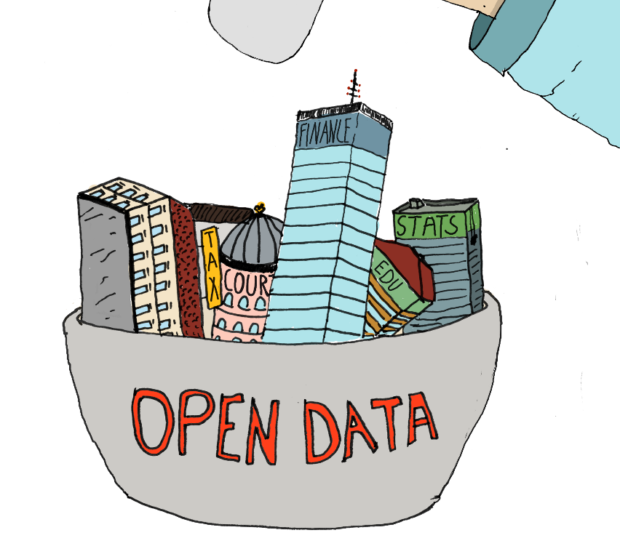
Problem Statement Linked Open Data Provisioning
From 12 datasets cataloged in 2007, the Linked Open Data has grown to almost 300 datasets
32 billion triples
Covering areas in education, transportation, consumer products, electricity, oil and gas, health care and consumer finance
The potential annual value enabled by Open Data in these domains estimates to reach 3 trillion US Dollars
“More Data beats better Algorithms”
But … is all data good data ?! Especially for enterprise use ?!
How will I be able to find relevant, good quality and license friendly data in this haystack ?!

Slide 4
Problem Statement The Need for Self-Service Data Provisioning
Business Intelligence (BI) has always been about creating new insight for business by converting data into meaning that can be shared between people to drive change in the organization
Classic BI and even the newer Agile Visualization tools focus much of their selling features on attractive and unique visualizations
However, provisioning data for those visualizations is by far the most challenging task in most BI projects large and small
Self Service data provisioning aims at tackling this problem by providing datasets discovery, acquisition and integration techniques intuitively to the end user

Slide 5

Use Case Business Intelligence Graph (BIG)
The Business Intelligence Graph (BIG) is a set of foundation services for BI applications such as SAP Lumira to facilitate quick and relevant access to analytical content for Decision Makers and Analysts
BIG Harvest BI artefacts, BI usage and user profiles from LDAP directories, online Wikis, communities, etc. and store them in the HANA Graph Engine
In addition to internal enterprise Data Provisioning, data residing in external repositories (data hubs, structured data in web pages, Linked Open Data, etc.) can bring new insights and enhance decision making process

Slide 6
Related Work
Searching online data portals:
There is a plethora of open online data portals like data.gov, publicdata.eu or private ones like Enigma or Quandl that provide search interfaces on top of their data repository
Open portals data quality depends on the quality of the raw data supplied by the publisher, whereas private portals manually curate and annotate their data
Microsoft curates public data from limited sources
A subset of Data.gov
The World Bank
HealthData.gov
Wikipedia Tables
Self-service Data Provisioning:
To our knowledge, Microsoft is the only company that integrates data with Power Query from different sources
Text-based sources: plain text, CSV, XML, Excel files, etc.
Web-based sources: tables on Web pages, Web APIs / JSON and OData

Slide 7
Challenges
Dataset Integration and Enrichment: large-scale Data Integration requires techniques that can automatically annotate datasets with rich semantic tags. This includes:
Finding the most relevant entity type for an instance within a given context
Finding the top properties of an entity
Identifying relevant data in Social Networks in a timely manner
Dataset Discovery: even though popular datasets like DBpedia and Freebase are well-known and widely used there are other “hidden” useful datasets that are difficult to find
Dataset Quality Control: Linked Data is a new type of structured information supported by models, ontologies and vocabularies and contains query endpoints and links. This makes data quality assurance a challenge

Slide 8
Proposal Architecture
DCAT Index
Semantic Social News Aggregator
Semantic Enricher
Data Profiler
Data Quality Controller
Contextual Entity Recognizer
Entity properties Ranker
Data Crawler
Open Data
Wikipedia
Web Data
Social Web
Dataset Integration and Enrichment
Dataset Discovery
Dataset Quality Control

Slide 9
Proposal Dataset Integration and Enrichment
DCAT Index
Semantic Social News Aggregator
Semantic Enricher
Data Profiler
Data Quality Controller
Contextual Entity Recognizer
Entity properties Ranker
Data Crawler
Open Data
Wikipedia
Web Data
Social Web
Dataset Integration and Enrichment
Dataset Discovery
Dataset Quality Control

Slide 10
Proposal Dataset Integration and Enrichment – Contextual Entity Recognizer
Progress: 30%
Publicly available endpoints of Knowledge Bases have several limitations e.g. servers downtime, API limit throttling, etc.
Data in external Knowledge Bases are not in a controlled environment – content can be updated at any point of time
The Contextual Entity Recognizer is able to identify the most relevant type of an entity taking into account contextual information i.e. When disambiguating entities in tabular data at the cellular level, other cells in the same column represents related context
The set of results are ranked according to a calculated confidence score

Slide 11
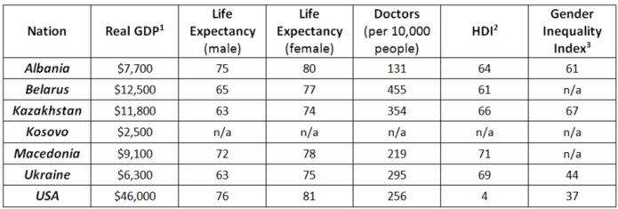
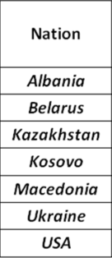
Proposal Dataset Integration and Enrichment – Semantic Enricher
Progress: 70%
The Semantic Enricher annotates datasets based on the semantics of the data at the instance level
Instead of looking at the table as a set of records with strings, we represent each instance at the cell level with a set of types retrieved from our Contextual Entity Recognizer
The column is represented now as a vector of rich types and their corresponding confidence
By normalizing the confidence scores and aggregating the set of types per column, we select the most common type to annotate and label the column
PL_C
PL_C
PL_C
country:87,3212, music album:12,331,Order of Chivalry:11,2321
……
…….

Slide 12

Proposal Dataset Integration and Enrichment – Semantic Enricher
Progress: 70%
We imported DBpedia into SAP HANA and provided an API with the following set of services:
Contextual Entity Disambiguation: Identifies the most relevant semantic type taking into account contextual information
Entity Enrichment: Retrieves extra properties of the disambiguated entity
Semantic Similarity: Uses Cosine Similarity, Pearson Product-Moment Correlation Coefficient (PPMCC) and Spearman's Rank Correlation Coefficient
The confidence score is calculated by combining the result from HANA built-in fuzzy text search with an indicator of the entity’s popularity
The popularity is computed by counting the number of incoming and outgoing associations

Slide 13
Proposal Dataset Integration and Enrichment – Semantic Enricher Evaluation
Progress: 70%
Evaluated against data coming from two SAP systems: The Event Tracker and Travel Expense Manager
The dataset used in our evaluation consists of around 60 columns and more than 1000 rows
We integrated our Semantic Similarity module in an existing schema matching tool called the Auto Mapping Core (AMC)
AMC is a flexible schema matching framework that combines the results of various similarity algorithms. This made it easier for us to measure the impact of our Semantic Similarity module

Slide 14
Proposal Dataset Integration and Enrichment – Semantic Enricher Evaluation
Progress: 70%
We proved that using the Semantic Enricher we managed not only to increase the overall confidence score with an average of 11% but also increase the number of valid matches found with an average of 10%
Columns now are labeled with new semantic labels that are unified across datasets with the same content types
Related Publications:
Ahmad Assaf et al. : RUBIX: a framework for improving data integration with linked data. WOD 2012
Ahmad Assaf et al. : Improving Schema Matching with Linked Data.CoRR abs/1205.2691 (2012)

Slide 15
Proposal Dataset Integration and Enrichment – Entity Properties Ranker
Progress: 80%
Columns and cells are reconciled with “semantic” entities using the Semantic Enricher
Entities are generally described with a lot of properties
It is, however, difficult to assess which ones are more “important" than others for particular tasks like data augmentation
We performed a reverse engineering of the Google Knowledge Graph Panel to find out what are the most “important" properties for an entity according to Google
We conducted a survey on 152 users which validated the results of our Entity Properties Ranker
We represent the results of our Entity Properties Ranker using the Fresnel vocabulary, so that any application could just use this knowledge to decide which properties of an entity is worth to be augmented with the current data
Submitted to the poster session at ESWC14

Slide 16

Proposal Dataset Integration and Enrichment – Social Media
DCAT Index
Semantic Social News Aggregator
Semantic Enricher
Data Profiler
Data Quality Controller
Contextual Entity Recognizer
Entity properties Ranker
Data Crawler
Open Data
Wikipedia
Web Data
Social Web
Dataset Integration and Enrichment
Dataset Discovery
Dataset Quality Control

Slide 17
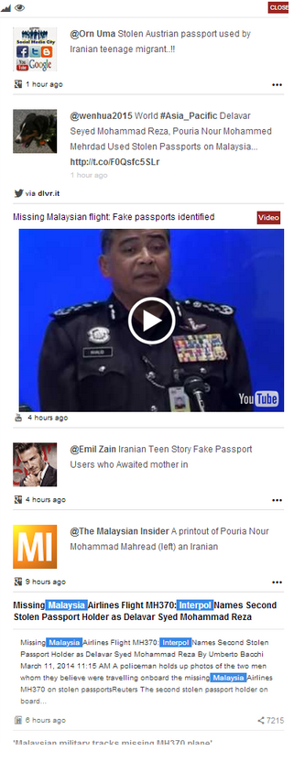

Proposal Dataset Integration and Enrichment – Semantic Social News Aggregator(SNARC)
Progress: 90%
SNARC is a service that extracts the semantic context of documents in order to recommend related content from the web and social media
SNARC enriches the user experience by allowing the user to get fresh perspective on what is happening as well as knowledge about identified concepts
SNARC provides a uniform semantic document model for web entities, whether they are blog entries, multimedia objects or micro-posts

Slide 18
Proposal Dataset Integration and Enrichment – Semantic Social News Aggregator (SNARC)
Progress: 90%
SNARC uses services like Zemanta and Alchemy to identify semantic entities in textual content and unifies Social Media content in a Semantic Document Model
SNARC federates queries to various Social Media sources like Twitter, Google+, YouTube, etc.
SNARC reconciles the results fetched to ensure their alignment and relevancy with the underlying model
SNARC has been implemented as a Chrome extension, but we plan to integrate it with business applications
The input for SNARC will be the annotations (entities, topics, categories) attached to data sources
Related Publications:
Ahmad Assaf, Aline Senart, Raphaël Troncy: SNARC - An Approach for Aggregating and Recommending Contextualized Social Content. ESWC (Satellite Events)
Winner of the AI Mash-up Challenge at ESWC13

Slide 19
Proposal Dataset Integration and Enrichment – Statistical Profiler (TBD)
DCAT Index
Semantic Social News Aggregator
Semantic Enricher
Data Profiler
Data Quality Controller
Contextual Entity Recognizer
Entity properties Ranker
Data Crawler
Open Data
Wikipedia
Web Data
Social Web
Dataset Integration and Enrichment
Dataset Discovery
Dataset Quality Control

Slide 20
Proposal Dataset Integration and Enrichment – Data Profiler (TBD)
Progress: 90%
The Data Profiler is used to examine the data to understand its content and structure
The types of profiling tasks include:
Statistical Tasks: Examining column data and getting statistical information such as min, max, average, median, null percentage, value distribution, pattern distribution
Dependency tasks: Finds the values in one or more dependent columns that rely on values in a primary column
Redundancy tasks: Determine the degree of overlapping data values or duplication between two sets of columns
Uniqueness tasks: Returns the count and percentage of rows that contain non-unique data, for the set of column(s) selected
Content type: Content type profiling provides suggested meaning based on the entities data in the columns

Slide 21

Proposal Data Quality Control
DCAT Index
Semantic Social News Aggregator
Semantic Enricher
Data Profiler
Data Quality Controller
Contextual Entity Recognizer
Entity properties Ranker
Data Crawler
Open Data
Wikipedia
Web Data
Social Web
Dataset Integration and Enrichment
90%
Dataset Discovery
Dataset Quality Control

Slide 22
Proposal Data Quality Controller – The Problem
Progress: 50%
Data quality involves data management, modeling, analysis, storage and presentation
It is an important issue for data-driven applications which should be deeply investigated and understood in order to ensure the data is fit to be combined and used to infer better business decisions
Data quality is subjective and cannot be assessed easily, the actual value of data is mainly realized when it is used
Studies found out that most data quality problems are in fact “data misinterpretations” or problems with the data semantics
Openness should be accompanied with a certain level of trust or guarantees about the quality of data
With the rise of Semantic Web, new data quality principles should be identified

Slide 23
Proposal Data Quality Controller– Contribution
Progress: 50%
We surveyed the landscape of Linked Data quality assessment frameworks
We surveyed the landscape of Linked Data quality assessment tools (25+ different tools)
We suggested an Objective Linked Data Quality Framework that consists of 13 different quality attribute
We have identified a total of 79 quality indicators to measure these abstract attributes

Slide 24
Proposal Data Quality Controller – Contribution
Progress: 50%
Building on the main four principles for publishing Linked Data, we grouped the quality attributes into four main categories:
Quality of the entities : quality indicators that focus on the data at the instance level (i.e. syntactic checkers)
Quality of the dataset: quality indicators at the dataset level
Quality of the semantic model: quality indicators that focus on the semantic models, vocabularies and ontologies
Quality of the linking process: quality indicators that focus on the inbound and outbound links between datasets

Slide 25
Proposal Data Quality Controller – Contribution
Progress: 50%
The Linked Data quality tools were grouped to reflect the different aspects of LOD:
Information Modeling Quality
Ontologies and Vocabularies Quality
Dataset Quality
Manual Ranking Tools
Automatic Ranking Tools
Links Based Approach
Provenance-based Approach
Entity-based Approach
Queryable End-point Quality

Slide 26
Proposal Data Quality Controller– Conclusion and Future Work
Progress: 50%
In the literature survey, we identified several gaps in the current tools landscape
We identified the need for a comprehensive evaluation and assessment framework
We plan to create an extensible component that will span all the identified data quality groups to produce a quality metric
Related Publications:
Ahmad Assaf, Aline Senart: Data Quality Principles in the Semantic Web. ICSC 2012

Slide 27
Proposal Dataset Discovery
DCAT Index
Semantic Social News Aggregator
Semantic Enricher
Data Profiler
Data Quality Controller
Contextual Entity Recognizer
Entity properties Ranker
Data Crawler
Open Data
Wikipedia
Web Data
Social Web
Dataset Integration and Enrichment
90%
Dataset Discovery
Dataset Quality Control
50%

Slide 28
Proposal Dataset Discovery – Open Data
We surveyed the landscape of private and public data portals ( 20+ portals)
We identified the lack of automatic methods to annotate data sets with semantically related tags which affects as well the search quality on these datasets
We plan to crawl data hubs that expose their datasets description via DCAT vocabulary. This choice came from the fact that the Open Data Support is promoting the DCAT-AP (and consequently DCAT) as the standard for describing datasets and catalogs in Europe.
We plan to enrich the DCAT description with the semantic annotations and statistical information retrieved from the Semantic Enricher

Slide 29
Proposal Dataset Discovery – Wikipedia Tables
Wikipedia is a rich resource of curated information on the web. Extracting knowledge from Wikipedia and presenting it in knowledge bases is implemented by DBpedia via the DBpedia information Extraction Framework
To our knowledge, there is no approach that leverages tabular information that exist in Wikipedia
We plan to use the DBpedia Information Extraction Framework to extract and expose knowledge found in tables across DBpedia
We need to implement mechanisms that are able to periodically check for updates and apply live updated when needed
The structured knowledge would leverage the contextual and topical information found in the page containing the table to further annotate the data with semantic rich tags

Slide 30
Proposal Dataset Discovery
DCAT Index
Semantic Social News Aggregator
Semantic Enricher
Data Profiler
Data Quality Controller
Contextual Entity Recognizer
Entity properties Ranker
Data Crawler
Open Data
Wikipedia
Web Data
Social Web
Dataset Integration and Enrichment
90%
Dataset Discovery
10%
Dataset Quality Control
50%

Slide 31
Conclusion
We have identified three main components that are needed to build a Self-Service Data Provisioning framework:
Dataset Integration and Enrichment: Uses semantic annotations to tag and enrich data. These can be used to enhance schema matching, data integration and augmentation
Dataset Discovery: Provides easy access to a unified view of publicly available datasets
Dataset Quality Control: Provides comprehensive quality metrics that are helpful in ranking datasets
We plan in the future to integrate this framework with the flagship BI product of SAP, Lumira

Slide 32
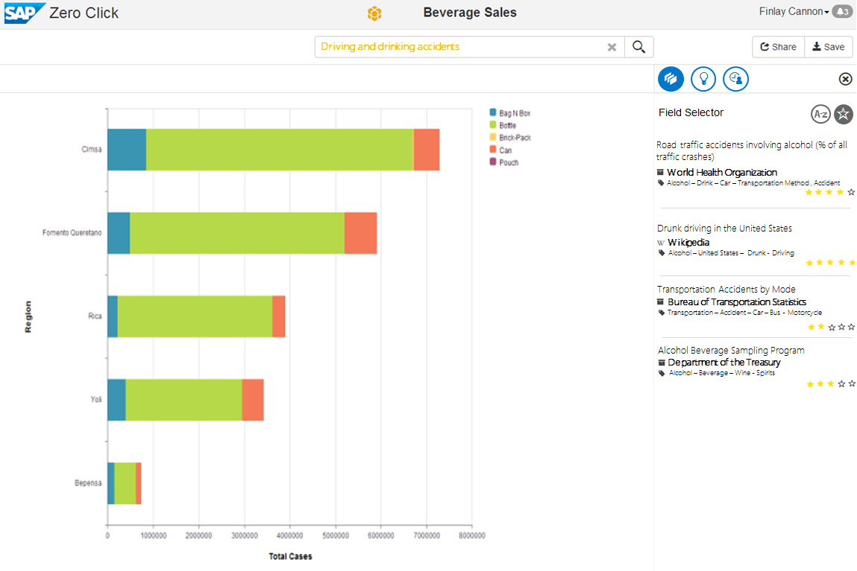

Slide 33
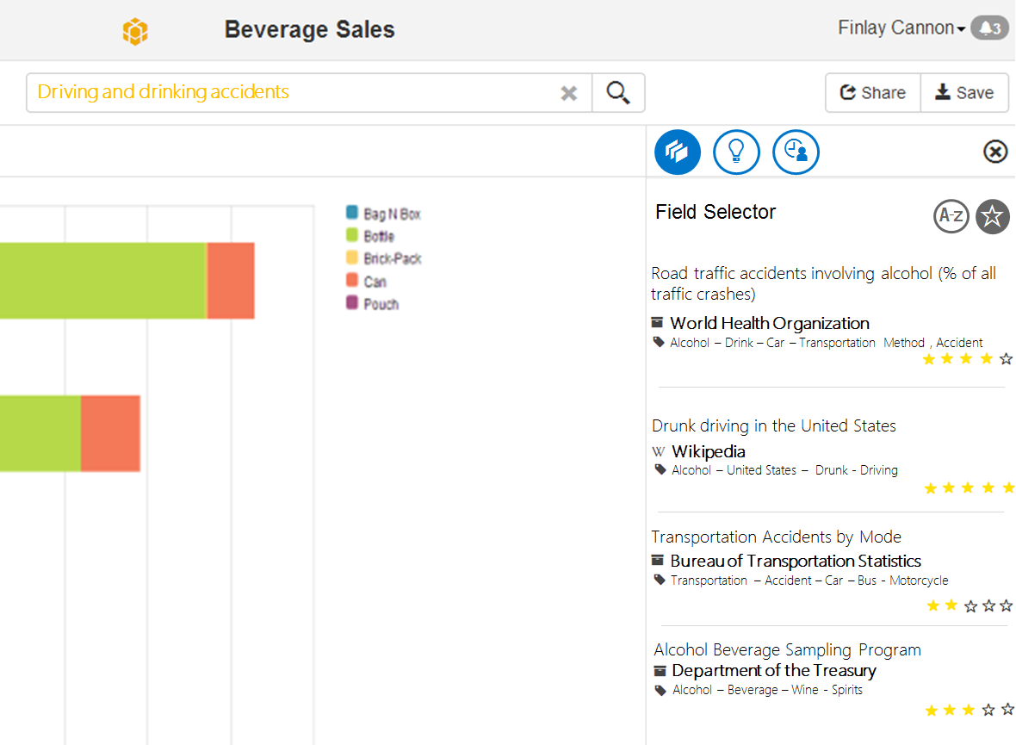
Conclusion

Slide 34
Thank You!
Contact information:
Ahmad Assaf
www.ahmadassaf.com
@ahmadaassaf
SAP Research, France
Ahmad.assaf@sap.com
+33 695 436 614

Slide 37
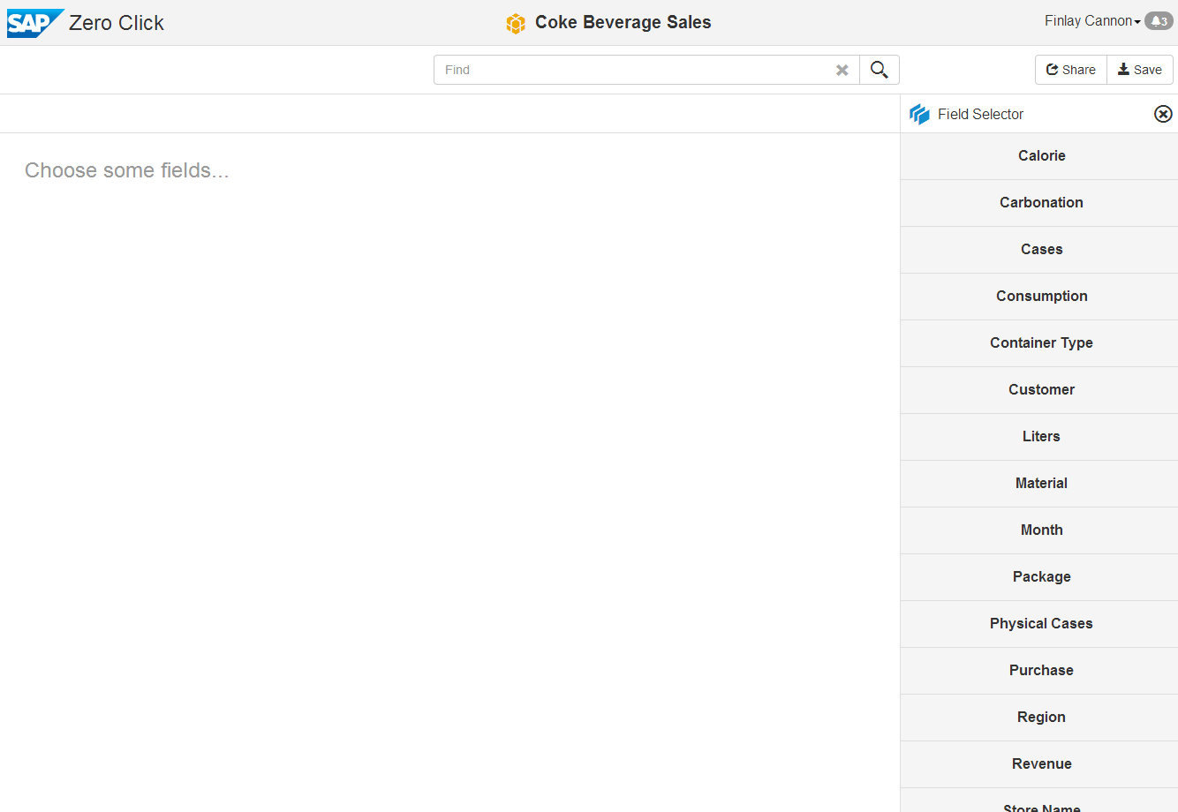
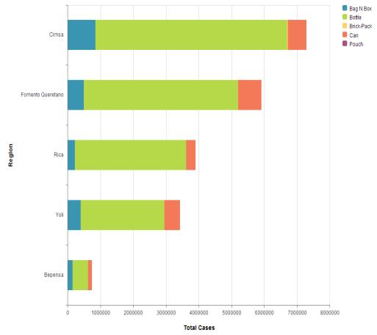
Driving and drinking accidents



Field Selector


Road traffic accidents involving alcohol (% of all traffic crashes)
World Health Organization
Alcohol – Drink – Car – Transportation Method , Accident
Drunk driving in the United States
Wikipedia
Alcohol – United States – Drunk - Driving
Transportation Accidents by Mode
Bureau of Transportation Statistics
Transportation – Accident – Car – Bus - Motorcycle
Alcohol Beverage Sampling Program
Department of the Treasury
Alcohol – Beverage – Wine - Spirits

